Slide 1
Mary Kay Pierce, BSN,
Executive Director
Annabelle Coffman, BA, Psych
Associate Director

Slide 2
Mission Statement: To improve the quality of life, ensure dignity and respect for persons with mental illness and to support their families.

Slide 3
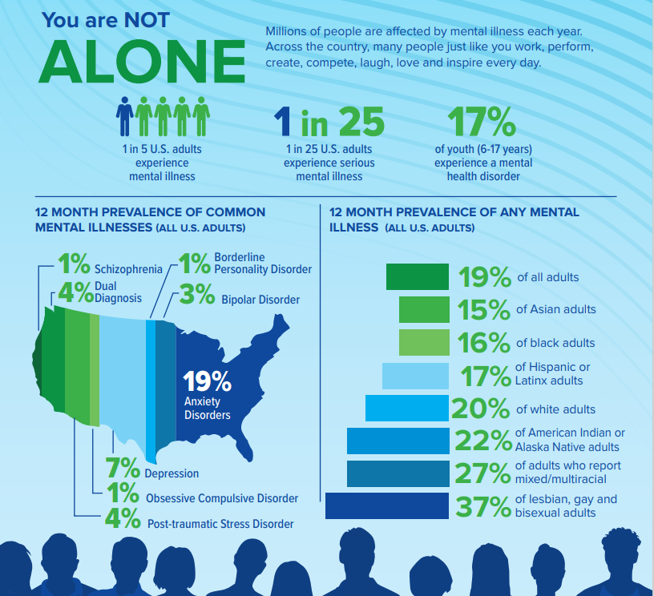
*stats from nami.org

Slide 4
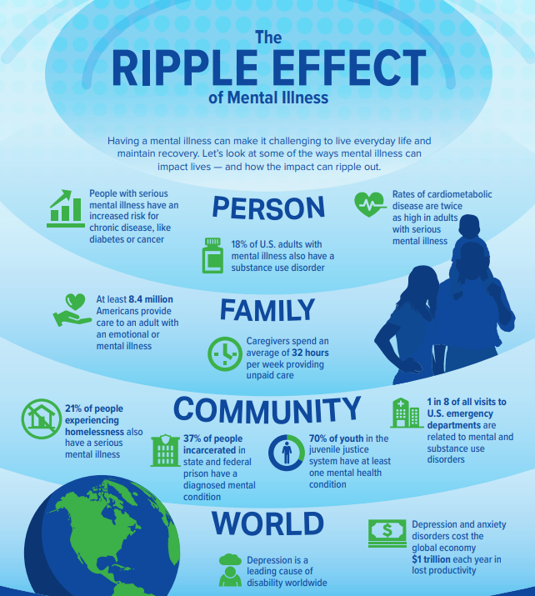
3 of the 10 leading causes of disability worldwide are
Depression
Schizophrenia
Bipolar Disorder
*stats from nami.org

Slide 5
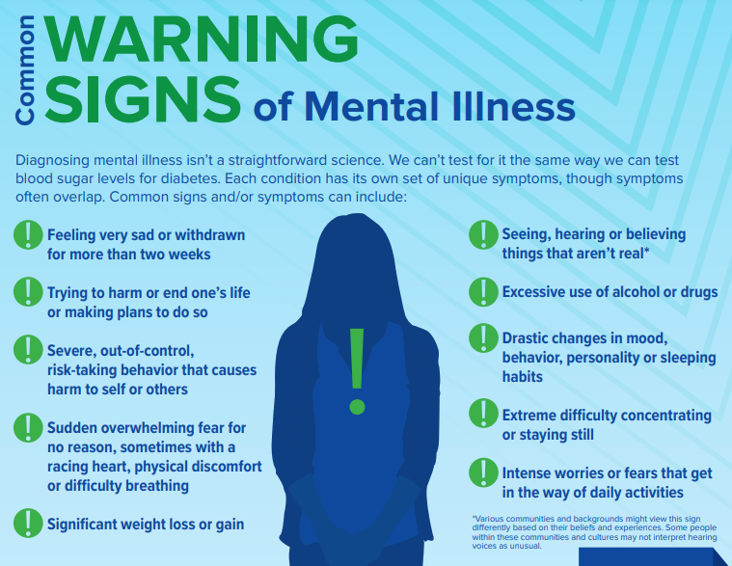
*stats from
nami.org

Slide 6
Why?

Slide 7
Cancer
Mental Illness
Fundraisers
Reach Out
Encourage
Make Food
Childcare
Meal Delivey
Pray for them
Support
Purchase a Pet
Drive to Appointments
Scared
Terminal
Treatment
Chemo
Shocked
Self-Esteem
Depression
Fear
Hair Loss
Pink
Shys Away
Ignore
Unnecessary Blame
Tip Toe Around
Withdrawal
Scared, Afraid
Misdiagnose
Just snap out of it
Refrain from talking
Denial
Get over it
Judge
Pretending for attention
“things could be worse

Slide 8
What is NAMI and what do we do?
Education
Advocacy
Support

Slide 9
Education
Family-to-Family Class
Family and Friends
Ending the Silence
Crisis Intervention Team (CIT) training

Slide 10
Advocacy
Local, State & National
Mental Health Court
Ohio Health
Suicide Prevention Coalition
Assisted Outpatient Treatment (AOT)
Phone calls

Slide 11
Support
NAMI on Campus
Connections Peer Support
Family Support Group
All-encompassing

Slide 12
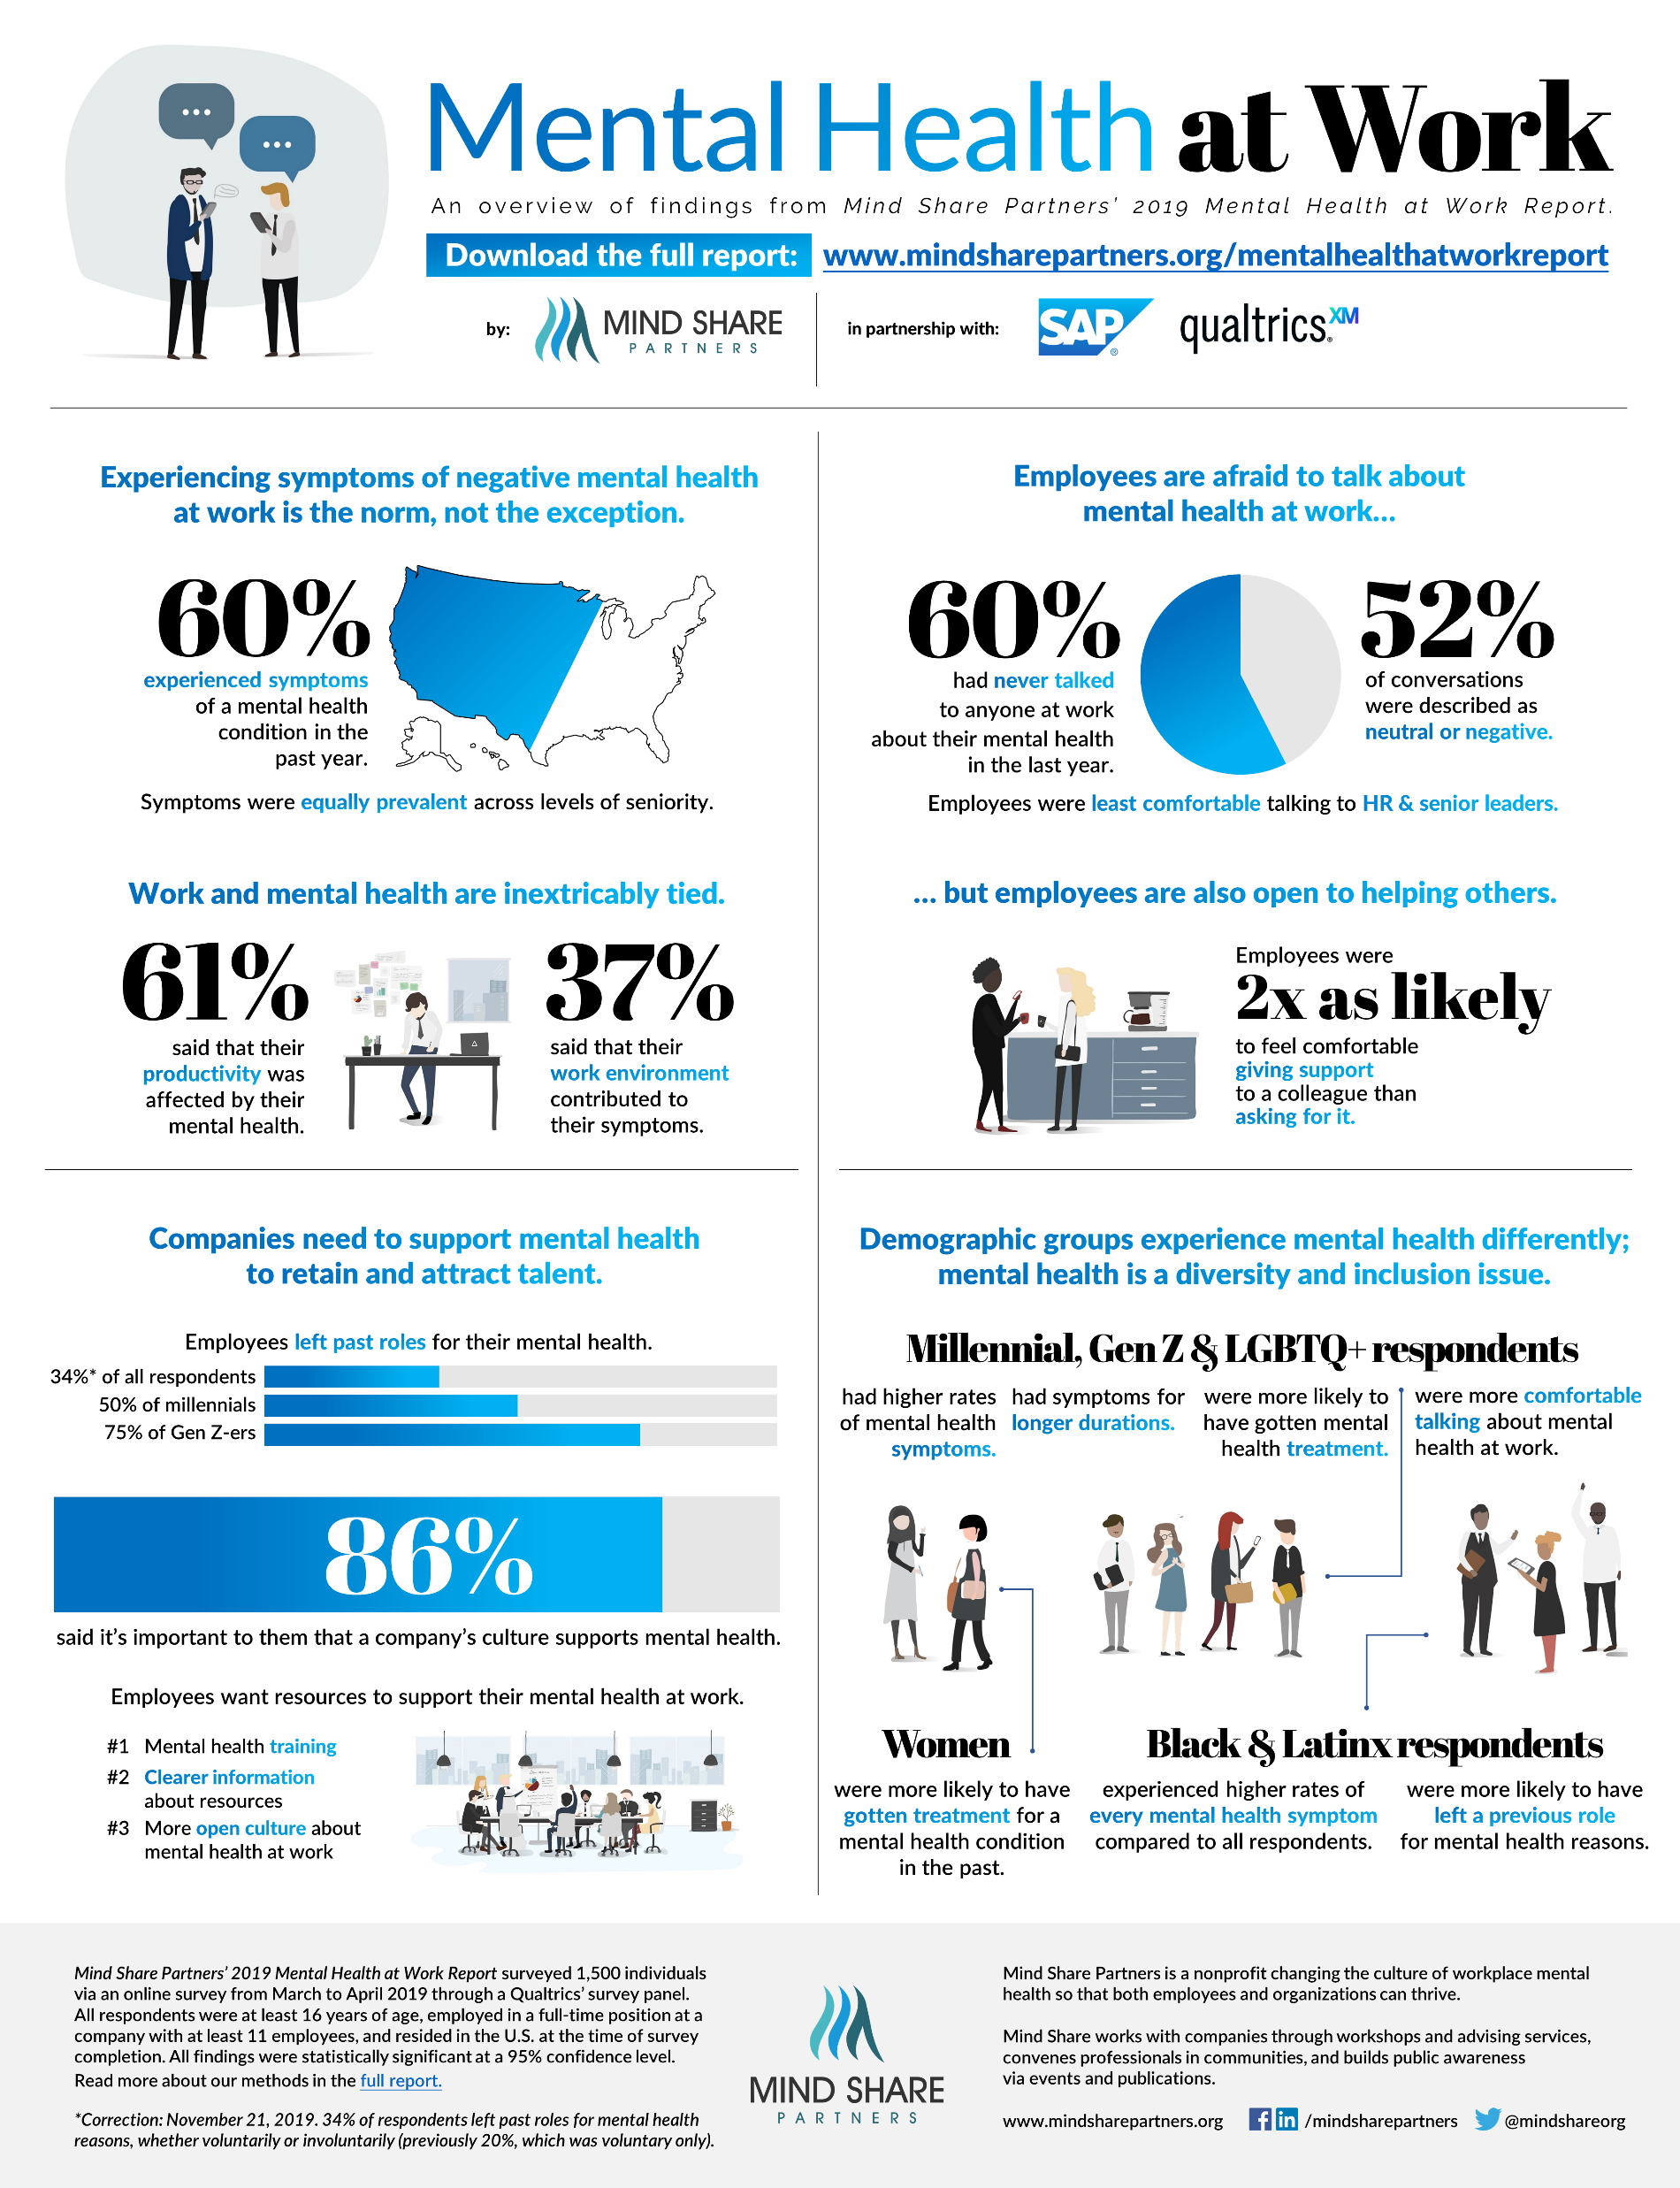

Slide 14
“At the end of March and in early April, our nonprofit organization, Mind Share Partners, conducted a study of global employees in partnership with Qualtrics and SAP. We found that the mental health of almost 42% of respondents had declined since the outbreak began. Given all that’s happened between then and now, we can only imagine that the figure has increased.” (Mind Share Partners, 2020)
In the U.S., 200 million workdays are lost due to mental health conditions (16.8 billion in employee productivity) and yet, almost 60% of employees have never spoken about their mental health status. (Harvard Business Review, Nov. 2019)
What can Employers do to help support mental health?

Slide 15
What can Employers do to help support mental health?
https://www.qualtrics.com/blog/confronting-mental-health/
Communication (Top-Down Process)
Transparency
Scheduled check-ins
Clear Expectations
Providing Resources

Slide 16
What can Employers do to help support mental health Cont.
Model Healthy Behaviors
- Self-care
- Being vulnerable and honest about your own mental health
- Share how you prioritize YOUR mental health

Slide 17
Create a supportive culture
Supportive, stigma-free language
Including mental health check-ins during meetings
Mental Health Days
Resources in Break Room
Appreciation and Awards
Educate mangers on how to name, normalize and navigate
What can Employers do to help support mental health Cont.?

Slide 18
Local Mental Health Resources
Providers: Knowitb4uneedit Campaign
https://richlandmentalhealth.com/service-providers/
Self-Care
https://www.newdirectionsforlife.com/
https://mindbodyalign.com/

Slide 19
Questions?
Contact info!
Phone: 419-522-6264
Email: families@namirc.org
Website: www.namirc.org
Fb: @namirichlandcounty
Insta: @namioncampus419

